Slide 1


NAME=SRUSHTI MUDHOLKAR
ROLL NO.=IT-2K19-60
TOPIC=CUSTOMER COMPLAINT
MANAGEMENT SYSTEM

Slide 2

CUSTOMER COMPLAINT MANAGEMENT SYSTEM

Slide 3
PURPOSE
It will explain the purpose and features of the system, the interfaces of the system, what the system will do, the constraints under which it must operate. This document is intended for both the users and the developers of the system . This software would help efficiently manage the complains of the customers efficiently and in turn would help them for better reach and customer satisfaction. Customer Complaint is important information showing customers sound and is a primary measure of customer dissatisfaction. An Effective and Efficient response to these complaints is an essential index of organization's performance

Slide 4
OBJECTIVES
The objective of the complaints management system is :-
To make complaints easier to coordinate, monitor, track and resolve
2. To provide company with an effective tool to identify and target problem areas, monitor complaints handling performance
3. To make business improvements.
4. Prompt and specific retrieval of data.
Flexibility in the system according to the changing environment.
6. Controlling redundancy in storing the same data multiple times.

Slide 5
7. Accuracy, timeliness and comprehensiveness of the system output.
8. Stability and operability by people of average intelligence.

Slide 6
PROJECT SCOPE
The Customer Complaint Management System aims to work across verticals and scales to every business size . This system will be designed to maximize the customer satisfaction by providing tools to assist in solving bugs and complaints more efficiently , which would otherwise have to be performed manually. By maximizing the company’s work efficiency the system will meet the users needs while remaining easy to understand and use. More specifically, this system is designed to allow a customer to be able to track the complaint status and be able to upgrade and renew their plans through the software.This is also developed for reducing the communication cost between the staffs and to provide the efficient service to their staffs.

Slide 7
TECHNOLOGY
SOFTWARE REQUIREMENTS:-
Operating System-MS WINDOWS XP or Above
Environment-java Runtime Environment7
Front end-JSP
Additional languages-Core java, HTML, Beams, CSS, Tomcat
Back end-Mysql

Slide 8
HARDWARE REQUIREMENTS
Processor :Intel Core 2 Duo or Above
System bus: 32 bits
RAM :2GB of RAM
HDD :100 GB or higher
Monitor :SVGA COLOR
Keyboard :108 Keys
Mouse: 2 button mouse

Slide 9
Advantages
The system will have great advantages over the traditional process keeping in mind its limitations
•Security
•Automation
•Report and tracking facility
•Less time consumption
•Customer satisfaction
•Easy processing
•Both mobile and PC compatible
•Reliable

Slide 10
Data Flow Diagram DFD
Data flow diagram(DFD) is a graphical representation of the “flow” of data through an information system.DFDs can also be used for visualization of data processing .On a DFD, data items flow from an external data source or an internal data store to an internal data store or an external data sink via an internal process.

Slide 11
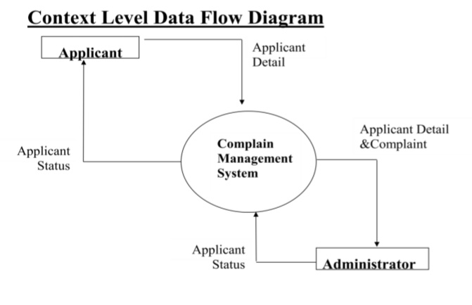
DATA FLOW DIAGRAM

Slide 12
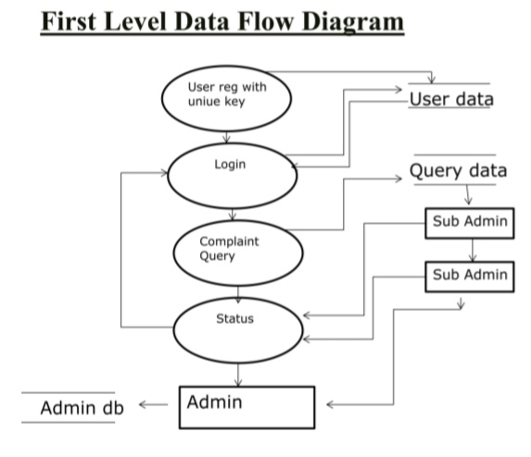
FIRST LEVEL DATA FLOW DIAGRAM

Slide 13
THANKYOU

